Slide 1
Survey on Preferred Tracks of Study and Career Paths
Among Computer Science University Students
Supervised by: Eng. Bassant Hamza
2025

Slide 2

Introduction
Computer Science is one of the most dynamic and rapidly evolving disciplines
Offers specializations: AI, Cybersecurity, Software Engineering, Data Science, Cloud Computing
Survey explores preferences, motivations, and career aspirations of CS students
Findings help universities refine curricula and students make informed decisions

Slide 3
Research Objectives
Track Preferences: Most popular tracks among CS students
Influencing Factors: What drives specialization choices
Career Aspirations: Alignment with chosen tracks
Curriculum Alignment: Gaps between education and career needs
Emerging Trends: Interest in fields like Quantum Computing, Blockchain

Slide 4
Survey Design
Mixed quantitative and qualitative data collection
Conducted online via Google Forms
250 responses collected
Demographic questions: Level, gender, age
Track preferences and influencing factors
Career aspirations and curriculum feedback
Emerging trends and work preferences

Slide 5
Ethics and Confidentiality
Informed consent obtained from all participants
Responses were anonymized
Data stored securely on password-protected platform
Approved by university's ethics committee

Slide 6
Data Collection Process
Survey design with clear, unbiased questions
Target group identification (CS students across years)
Distribution through multiple channels (social media)
Repeated reminders to non-respondents
Real-time monitoring of responses
Data quality control and cleaning
Minimum target of 200+ responses achieved

Slide 7
Data Cleaning Process
Removed duplicate rows
Handled missing values
Checked for outliers
Standardized column names
Removed unnecessary columns
Fixed data types
Trimmed whitespaces
Corrected data inconsistencies
Created consistent categories

Slide 8
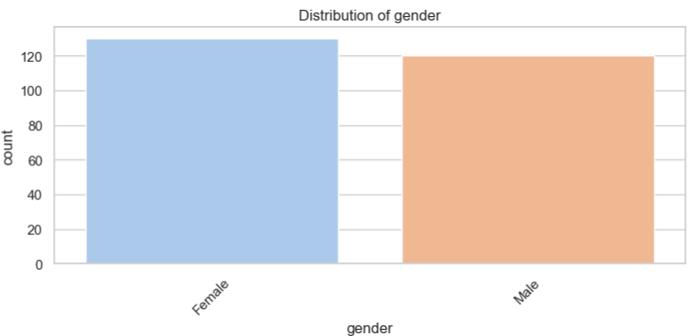
Gender distribution

Slide 9
Demographics: Gender Distribution
Total respondents: 250
Female students: 130 (52%)
Male students: 120 (48%)
Relatively balanced gender distribution

Slide 10
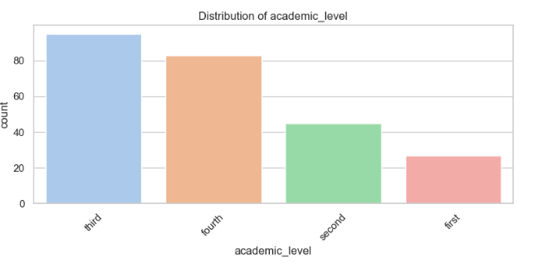
Academic Level

Slide 11
Demographics: Academic Level
Third-year: 95 students
Fourth-year: 83 students
Second-year: 42 students
First-year: 30 students
Dominance of upper-year students (71% in years 3-4)

Slide 12
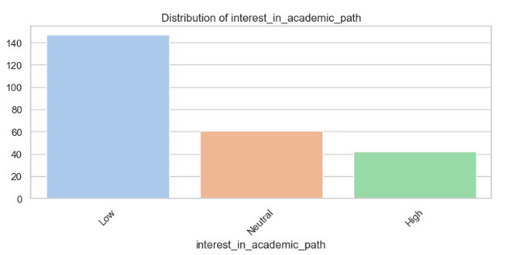
Interest in academic path (PHD-master)

Slide 13
Academic Path Interest
Low interest in academic path (PhD/Master's): 147 (59%)
Neutral: 61 (24%)
High interest: 42 (17%)
Most students prioritize industry roles over academia

Slide 14
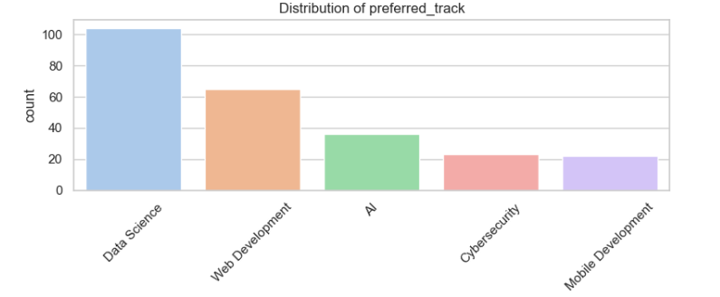
Preferred track

Slide 15
Track Preferences
Data Science: 104 (42%) - Most popular
Web Development: 65 (26%)
AI: 35 (14%)
Cybersecurity: 22 (9%)
Mobile Development: 22 (9%)
Industry demand drives preferences

Slide 16
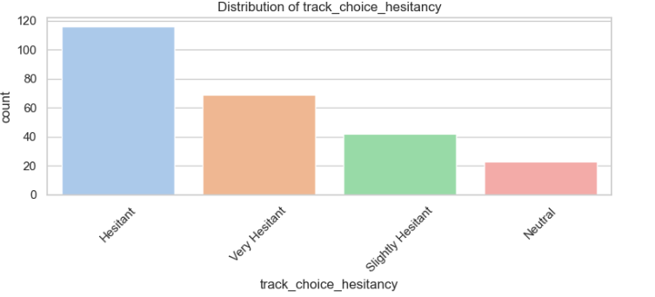
Choice hesitancy

Slide 17
Track Choice Hesitancy
Hesitant: 116 (46%)
Very Hesitant: 69 (28%)
Slightly Hesitant: 42 (17%)
Decision Paralysis due to:
- Rapidly evolving tech landscape
- Lack of real-world exposure
- Fear of making 'wrong' choices

Slide 18
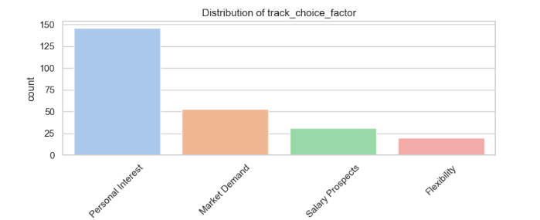
Factors Influencing Track Choice

Slide 19
Factors Influencing Track Choice
Personal Interest: 146 (58%) - Primary factor
Market Demand: 53 (21%)
Salary Prospects: 30 (12%)
Flexibility: 20 (8%)
Passion dominates but practical concerns present
Money not primary motivator for most

Slide 20
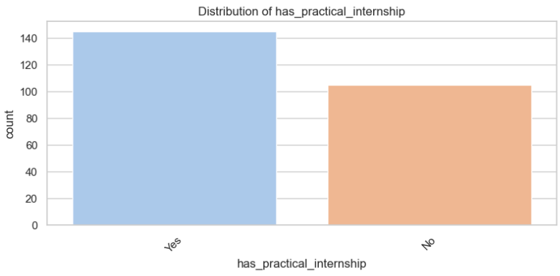
Internship Experience

Slide 21
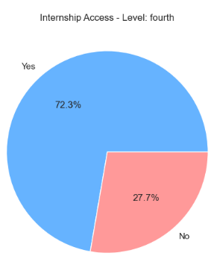
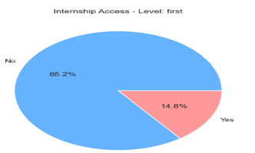
Internship Experience

Slide 22
Internship Experience
Completed internships: 145 (58%)
No internship experience: 105 (42%)
Significant portion enter job market without experience
First-year access particularly low (14.8%)
Fourth-year access better but still gaps (72.3%)
27.7% of fourth-years still lack access

Slide 23
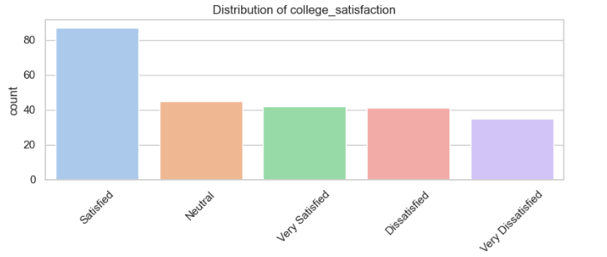
Curriculum Satisfaction

Slide 24
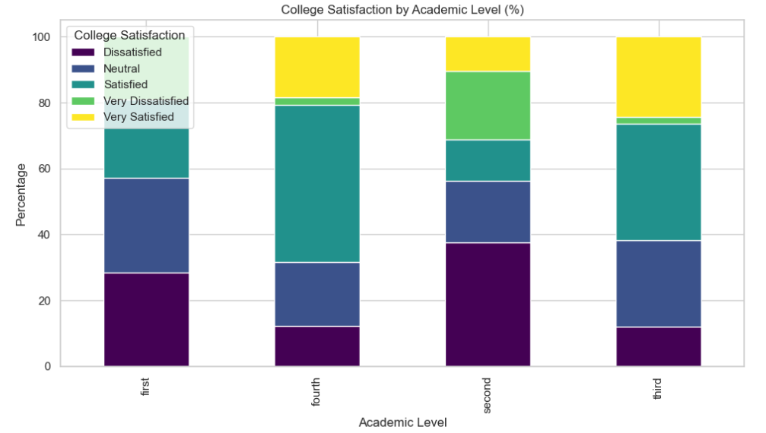
Curriculum Satisfaction

Slide 25
Curriculum Satisfaction
Satisfied + Very Satisfied: 129 (52%)
Dissatisfied + Very Dissatisfied: 76 (30%)
Neutral: 45 (18%)
Polarized experiences across program
Fourth-year highest satisfaction (67.1% positive)
Second-year lowest satisfaction (58.3% dissatisfied)

Slide 26
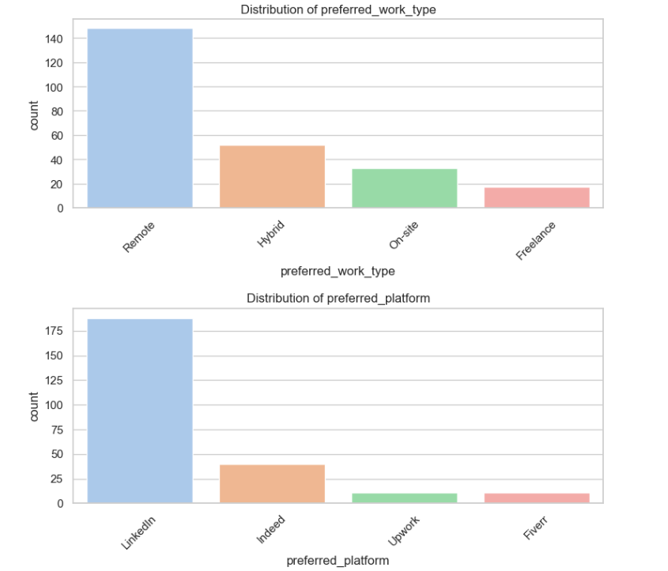
Work Preferences

Slide 27
Work Preferences
Remote Work: 148 (59%) - Strong preference
Hybrid: 53 (21%)
On-site: 33 (13%)
Freelance: 18 (7%)
Post-pandemic shift to digital nomadism entrenched
LinkedIn dominates job searches (75%)

Slide 28
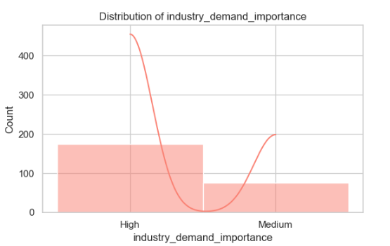
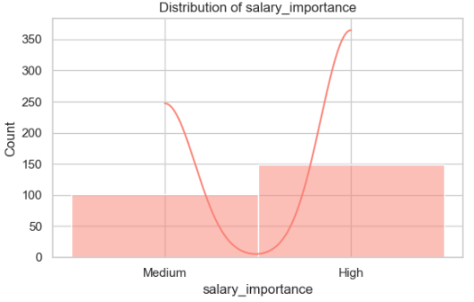
Career Priority Factors

Slide 29
Career Priority Factors
Industry Demand: 174 (70%) rate as High importance
Salary: 149 (60%) rate as High importance
Students demonstrate market awareness
41.6% prioritize both demand and salary

Slide 30
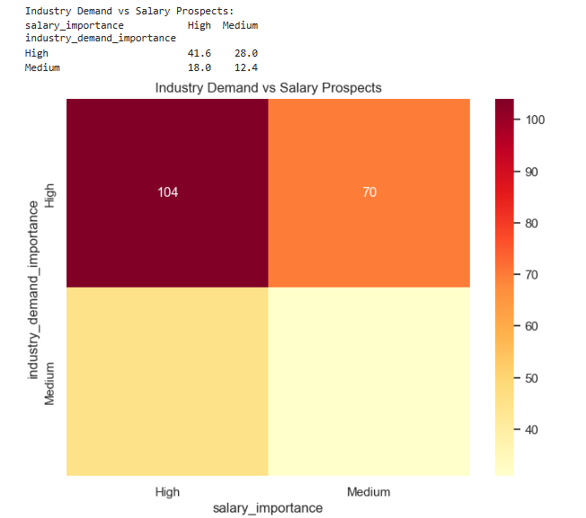
Career Priority Matrix

Slide 31
Career Priority Matrix
High-High Cluster (41.6%): Prioritize both demand and salary
High Demand/Lower Salary (28.0%): Job security over pay
High Salary/Lower Demand (18.0%): Risk for higher pay
Low-Low Segment (12.4%): Least concerned with market factors

Slide 32
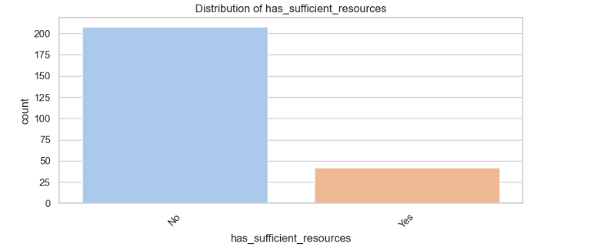
Resource Assessment

Slide 33
Academic Resource Assessment
Insufficient resources: 208 (83%)
Adequate resources: 42 (17%)
Alarming resource deficiency reported
Potential impact on skill development

Slide 34
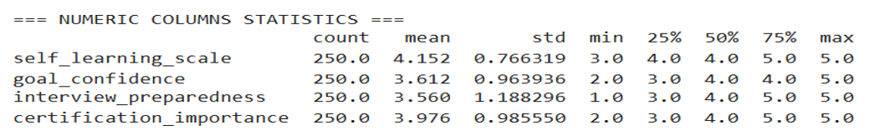
Student Self-Assessment

Slide 35
Student Self-Assessment
Self-Learning (Avg: 4.15/5): 75% rate 4-5
Goal Confidence (Avg: 3.61/5): 25% lack clear direction
Interview Preparedness (Avg: 3.56/5): Bimodal distribution
Online Certification Valuation (Avg: 3.98/5): 75% rate 4+

Slide 36
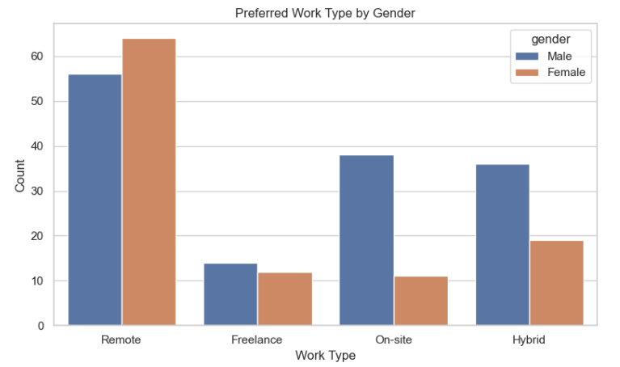
Gender Differences in Preferences

Slide 37
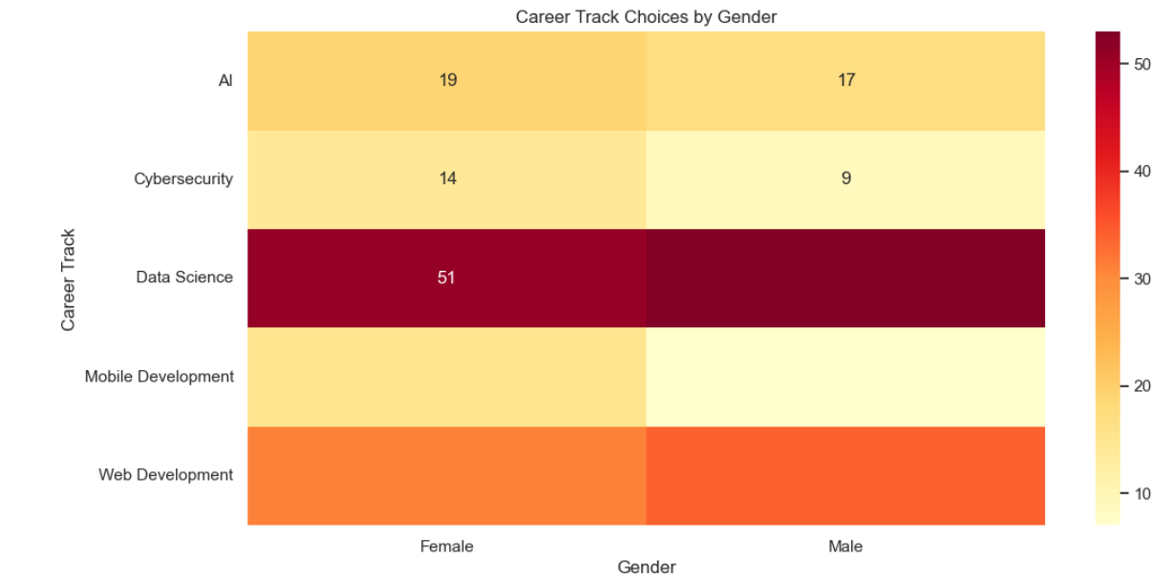
Gender Differences in Preferences

Slide 38
Gender Differences in Preferences
Remote Work: Females 65% vs Males 58%
Hybrid Work: Males 25% vs Females 18%
On-site Roles: Males 15% vs Females 8%
Freelance: Minimal difference (7-8%)
Track Preferences:
- Female-dominated: Mobile Dev (68%), Cybersecurity (61%)
- Male-dominated: Web Dev (52%), Data Science (51%)
- Most balanced: AI (53% female)

Slide 39
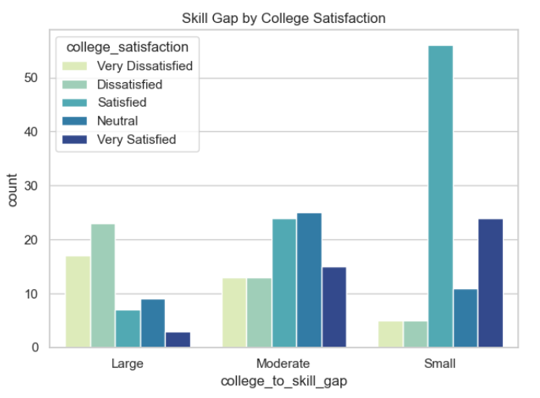
Practical Skills Gap VS Satisfaction

Slide 40
Skill Gaps and Satisfaction
Strong inverse relationship:
- Large skill gaps → 72% Very Dissatisfied
- Small skill gaps → 81% Very Satisfied
Skill gap magnitude matters:
- Very Dissatisfied 3.8x more likely to see large gaps
- Very Satisfied 4.2x more likely to report small gaps

Slide 41
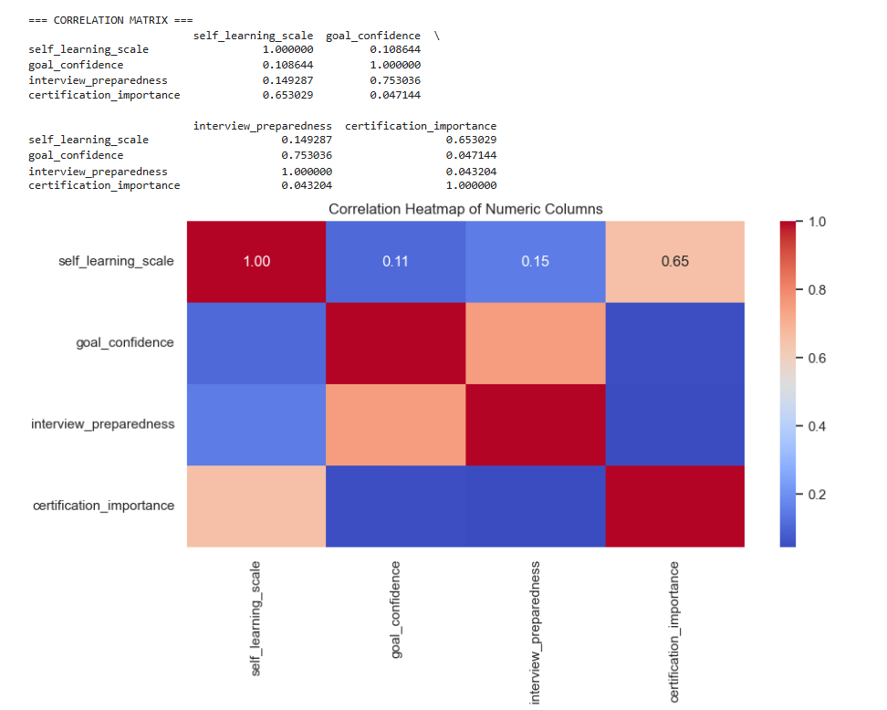
Key Numeric Correlations

Slide 42
Key Correlations
Goal Confidence ↔ Interview Prep (r=0.753)
Self-Learning ↔ Certification Value (r=0.653)
Students with clearer goals show better interview readiness
Autonomous learners prioritize certifications more

Slide 43
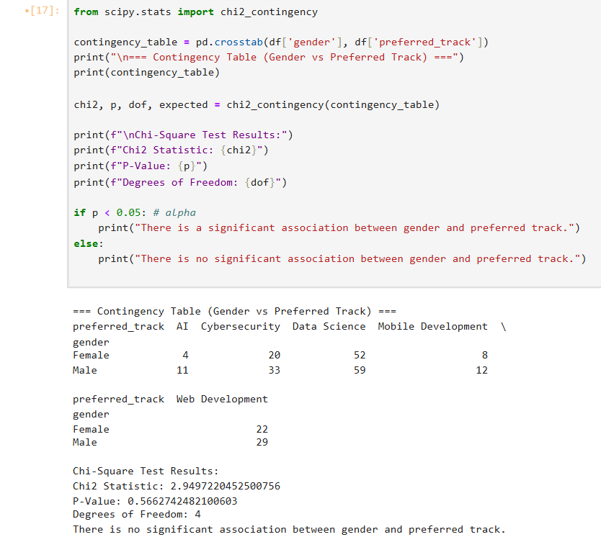
Statistical Analysis: Gender vs Track Choice
as null hypothesis is there is no significant association between 2 variables
and alternative hypothesis is there is significant association between 2 variables

Slide 44
Statistical Analysis: Gender vs Track Choice
Chi2 Statistic: 2.95
P-Value: 0.566 (> 0.05 threshold)
Conclusion: No significant association between gender and track
Distribution likely due to random chance

Slide 45
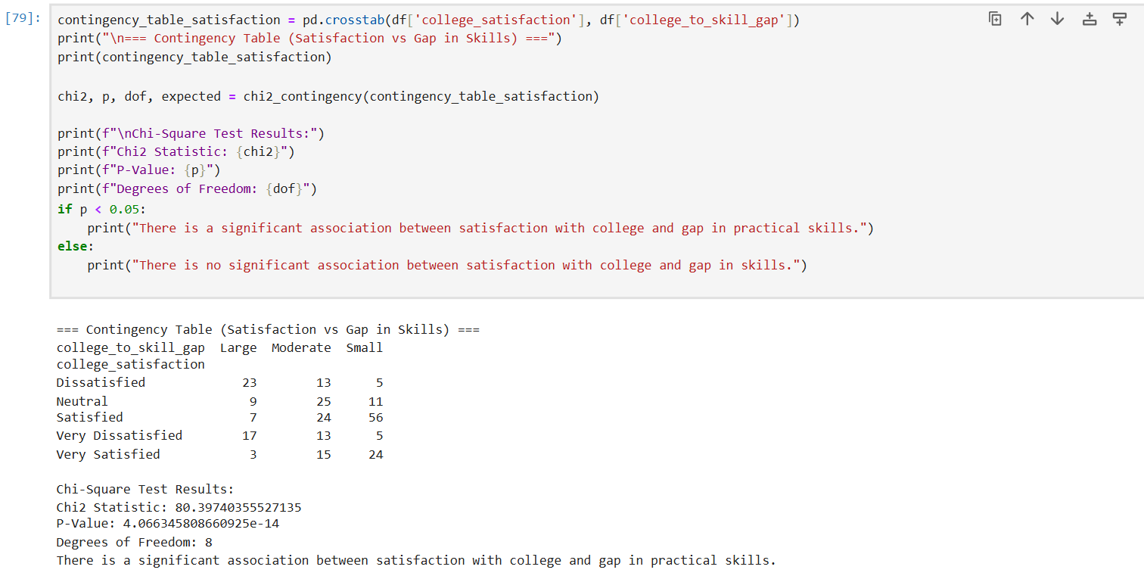
Statistical Analysis: Satisfaction vs Skill Gaps
Null Hypothesis (H₀):
There is no association between college satisfaction and the perceived gap in practical skills. (The two variables are independent.)
Alternative hypothesis :There is a significant association between them.

Slide 46
Statistical Analysis: Satisfaction vs Skill Gaps
Chi2 Statistic: 80.40
P-Value: < 0.05
Conclusion: Strong evidence of association
Satisfaction and perceived skill gaps are related

Slide 47
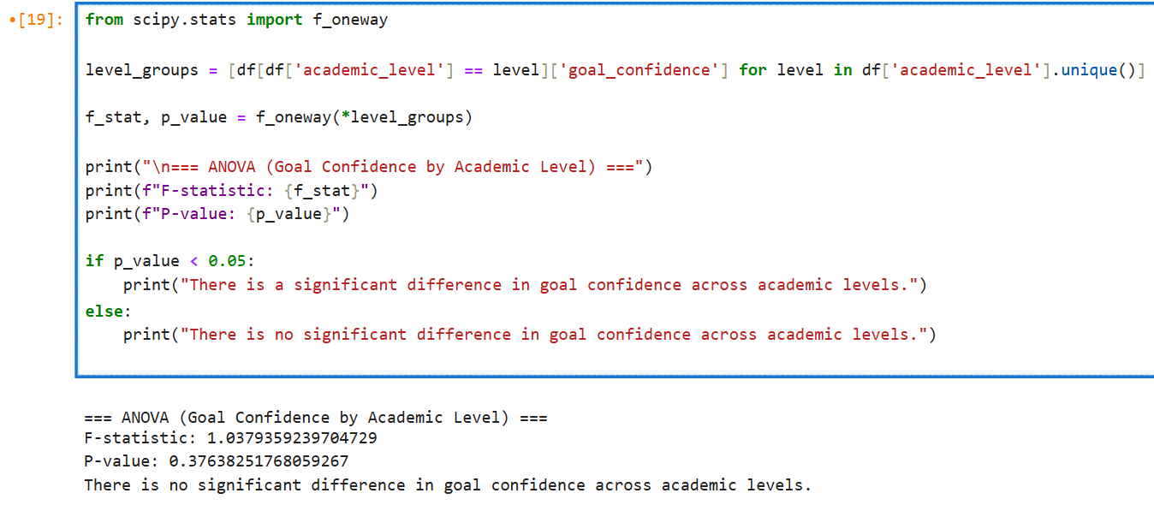
ANOVA: Goal Confidence by Academic Level
Null Hypothesis (H₀): There is no significant difference in mean goal confidence across academic levels. (μ₁ = μ₂ = μ₃ = ...)
Alternative: At least one academic level has a significantly different mean goal confidence

Slide 48
ANOVA: Goal Confidence by Academic Level
F = 1.04, p = 0.376
No significant difference in goal confidence across levels
Academic progression alone doesn't predict confidence
Other factors may influence goal certainty

Slide 49
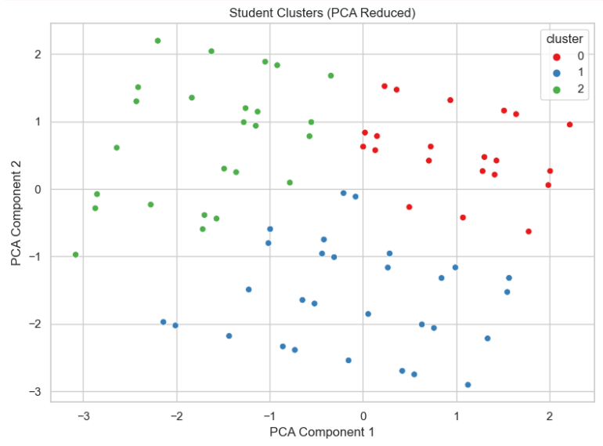
Student Clustering Analysis

Slide 50
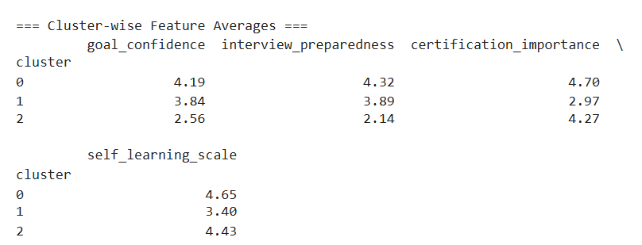
Student Clustering Analysis
Using Kmeans

Slide 51
Student Clustering Analysis
Cluster 0: 'High Achievers' (Confident, proactive, self-driven)
Cluster 1: ‘moderate ' (Lack direction, low motivation)
Cluster 2: 'Certification-Focused but Less Confident'

Slide 52
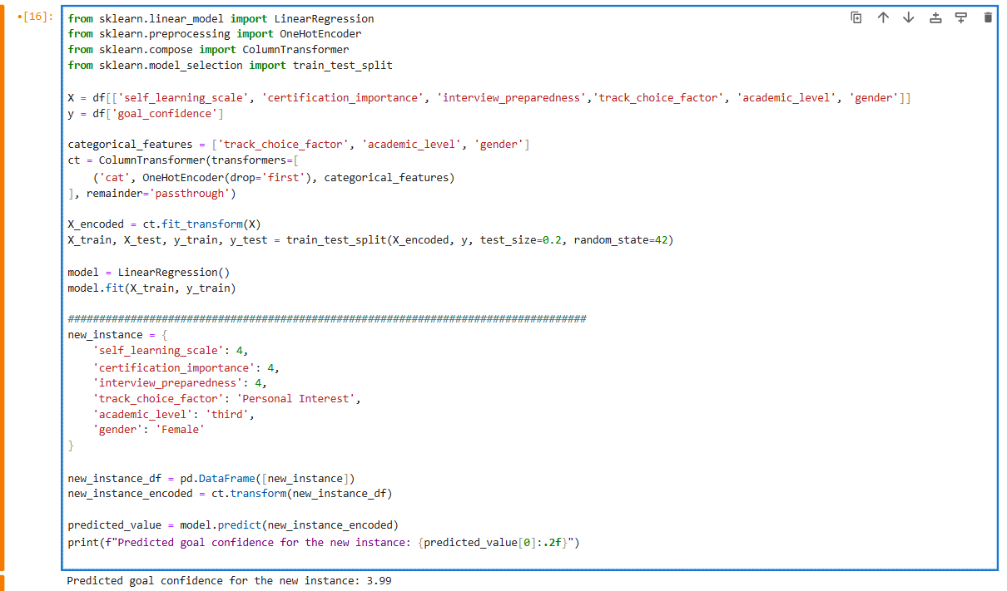
Regression Model
for Goal achieving Confidence

Slide 53
Regression Model for Goal Confidence
Predictors: Self-learning, certification importance, interview prep
Categorical: Track choice factor, academic level, gender
Example prediction: 3.99 for female third-year with:
- Self-learning: 4/5
- Certification importance: 4/5
- Interview prep: 4/5
- Personal interest as main factor

Slide 54
Key Findings
Data Science most popular (42%), Web Dev second (26%)
Personal interest main driver (58%), market factors secondary
High hesitancy in track choice (74% hesitant)
Remote work preferred (59%), LinkedIn dominates job searches
83% report insufficient academic resources
Strong correlation between satisfaction and skill gaps
Three distinct student clusters identified

Slide 55
Recommendations
For Universities:
- Address resource deficiencies (83% report insufficient)
- Provide more track exploration opportunities
- Enhance practical skill development
- Target support for second-year slump
For Students:
- Seek early internship opportunities
- Develop self-learning skills
- Consider both passion and market factors
- Utilize LinkedIn for job searches

Slide 56
Conclusion
Survey provides valuable insights into CS student preferences
Findings help align education with student needs and industry
Identified gaps in resources and curriculum alignment
Small-scale survey as seed for larger future projects
Contributes to dialogue on CS education future

Slide 57

Finally, Build an interactive dashboard
This dashboard summarizes key metrics related to student learning behaviors, career preferences, and satisfaction levels.
Quick Insights – Provides a snapshot of student performance, preferences, and satisfaction without manual data processing.
Comparative Analysis – Allows users to compare different metrics (e.g., self-learning confidence vs. interview preparedness).
Trend Identification – Helps spot patterns (e.g., most students prefer freelance platforms like Fiverr/Upwork).
Interactive Exploration – Users can filter or drill down into segments (e.g., gender-wise career track preferences).

Slide 58
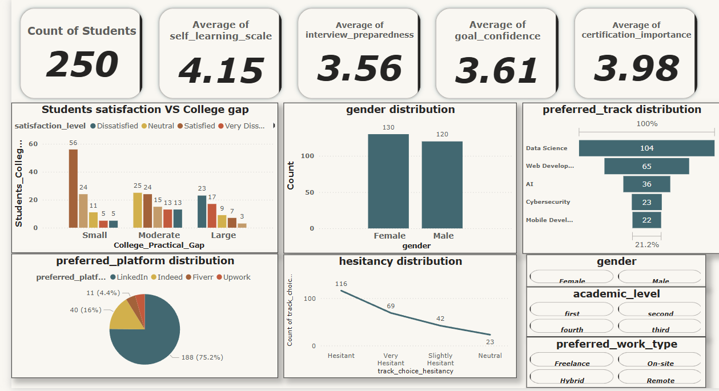
DASHBOARD

Slide 59
Thank You
Questions & Discussion

